Slide 1
Kodak Gallery
the next generation
Sherry Bai, Michelle Jacobs, Melissa Lamb, Adela Mou
University of Pennsylvania

Slide 2
Roadmap – a look ahead
imc
website
strategy

Slide 3
Roadmap – a look ahead
imc
website
 | Target Market Website Vision
strategy

Slide 4
Roadmap – a look ahead
imc
 | Features & Services Profitability & Growth
website
strategy

Slide 5
Roadmap – a look ahead
imc
 | Marketing Plan
website
strategy

Slide 6
[strategy] website imc
the next generation :: Kodak Gallery

Slide 7
Situational Analysis
 | Internal | External
Positive | Strengths Industry expertise Existing client base Brand equity and brand heritage | Opportunities Geographic separation of families Tech-savvy mothers & grandparents Underserved grandparent demographic
Negative | Weaknesses Weak associations to digital Underdeveloped website interface Broad targeting | Threats Rapidly changing technological environment Increased competition Popularity of social networks

Slide 8
Situational Analysis
 | Internal | External
Positive | Strengths Industry expertise Existing client base Brand equity and brand heritage | Opportunities Geographic separation of families Tech-savvy mothers & grandparents Underserved grandparent demographic
Negative | Weaknesses Weak associations to digital Underdeveloped website interface Broad targeting | Threats Rapidly changing technological environment Increased competition Popularity of social networks

Slide 9
Situational Analysis
 | Internal | External
Positive | Strengths Industry expertise Existing client base Brand equity and brand heritage | Opportunities Geographic separation of families Tech-savvy mothers & grandparents Underserved grandparent demographic
Negative | Weaknesses Weak associations to digital Underdeveloped website interface Broad targeting | Threats Rapidly changing technological environment Increased competition Popularity of social networks

Slide 10
Situational Analysis
 | Internal | External
Positive | Strengths Industry expertise Existing client base Brand equity and brand heritage | Opportunities Geographic separation of families Tech-savvy mothers & grandparents Underserved grandparent demographic
Negative | Weaknesses Weak associations to digital Underdeveloped website interface Broad targeting | Threats Rapidly changing technological environment Increased competition Popularity of social networks

Slide 11
Situational Analysis
 | Internal | External
Positive | Strengths Industry expertise Existing client base Brand equity and brand heritage | Opportunities Geographic separation of families Tech-savvy mothers & grandparents Underserved grandparent demographic
Negative | Weaknesses Weak associations to digital Underdeveloped website interface Broad targeting | Threats Rapidly changing technological environment Increased competition Popularity of social networks

Slide 12
Research Methodology
Qualitative |  | Quantitative
Focus Groups | Usability Interviews | Comprehensive Survey | Website Survey
Teens Grandparents Moms (2) | One-on-one website interface & usability interviews | Comprehensive survey for segmentation data and habits | Follow-up website survey for site design and features

Slide 13
Research Methodology
Qualitative |  | Quantitative
Focus Groups | Usability Interviews | Comprehensive Survey | Website Survey
Teens Grandparents Moms (2) | One-on-one website interface & usability interviews | Comprehensive survey for segmentation data and habits | Follow-up website survey for site design and features

Slide 14
Research Methodology
Qualitative |  | Quantitative
Focus Groups | Usability Interviews | Comprehensive Survey | Website Survey
Teens Grandparents Moms (2) | One-on-one website interface & usability interviews | Comprehensive survey for segmentation data and habits | Follow-up website survey for site design and features

Slide 15
Research Methodology
Qualitative |  | Quantitative
Focus Groups | Usability Interviews | Comprehensive Survey | Website Survey
Teens Grandparents Moms (2) | One-on-one website interface & usability interviews | Comprehensive survey for segmentation data and habits | Follow-up website survey for site design and features

Slide 16
Choosing a Demographic
 | Teens | Grandparents | Moms
Size | Small Oversaturated | Large Underserved | Large
Behavior | Social Networks | Active Online | E-mail Open to Online Services
Perception | Outdated | Category Exemplar | High Quality
Profitability | Rarely Print | Prefer Prints | Love Photo Gifts

Slide 17
Choosing a Demographic
 | Teens | Grandparents | Moms
Size | Small Oversaturated | Large Underserved | Large
Behavior | Social Networks | Active Online | E-mail Open to Online Services
Perception | Outdated | Category Exemplar | High Quality
Profitability | Rarely Print | Prefer Prints | Love Photo Gifts

Slide 18
Choosing a Demographic
 | Teens | Grandparents | Moms
Size | Small Oversaturated | Large Underserved | Large
Behavior | Social Networks | Active Online | E-mail Open to Online Services
Perception | Outdated | Category Exemplar | High Quality
Profitability | Rarely Print | Prefer Prints | Love Photo Gifts

Slide 19
Choosing a Demographic
 | Teens | Grandparents | Moms
Size | Small Oversaturated | Large Underserved | Large
Behavior | Social Networks | Active Online | E-mail Open to Online Services
Perception | Outdated | Category Exemplar | High Quality
Profitability | Rarely Print | Prefer Prints | Love Photo Gifts

Slide 20
Choosing a Demographic
 | Teens | Grandparents | Moms
Size | Small Oversaturated | Large Underserved | Large
Behavior | Social Networks | Active Online | E-mail Open to Online Services
Perception | Outdated | Category Exemplar | High Quality
Profitability | Rarely Print | Prefer Prints | Love Photo Gifts

Slide 21
Choosing a Demographic
 | Teens | Grandparents | Moms
Size | Small Oversaturated | Large Underserved | Large
Behavior | Social Networks | Active Online | E-mail Open to Online Services
Perception | Outdated | Category Exemplar | High Quality
Profitability | Rarely Print | Prefer Prints | Love Photo Gifts

Slide 22
Moms as Active Diffusers

Slide 23
Segmentation
Benefits-Sought Segmentation
Actionable

Slide 24
Segmentation
Benefits-Sought Segmentation
Actionable
Demographic and Lifestyle Segmentation
Harder to develop differentiated offering
Momfluential*
“Female, ages 25 - 54, with children under the age of 18 at home and an average household income of over $75,000.”
“Sophisticated web user, highly connected, owner of a digital camera and has broadband.”
*2008-2009 AMA Collegiate Case Competition: “Kodak Gallery: The Next Generation”

Slide 25
Segmentation & Targeting
 | Safeguard Susan | Creative Kate | Community Carol | Connector Connie
Size | 15% | 20% | 32% | 33%
Benefit | Security | Creative Outlet | Discussion | Emotional Connection
Profitability | No purchases | Photo Gifts | No purchases | Prints Photo Gifts
Accessibility | Offline (Shoebox) | Offline (Scrapbooking) | Online (Saturated) | Online (Underserved)

Slide 26
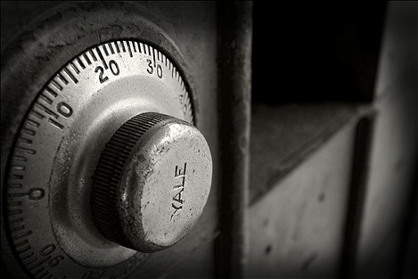
Segmentation & Targeting
 | Safeguard Susan | Creative Kate | Community Carol | Connector Connie
Size | 15% | 20% | 32% | 33%
Benefit | Security | Creative Outlet | Discussion | Emotional Connection
Profitability | No purchases | Photo Gifts | No purchases | Prints Photo Gifts
Accessibility | Offline (Shoebox) | Offline (Scrapbooking) | Online (Saturated) | Online (Underserved)

Slide 27
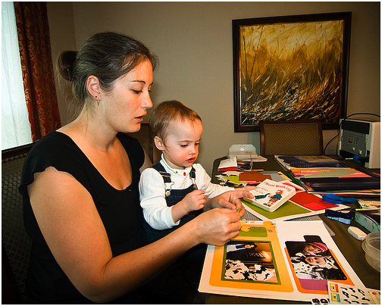
Segmentation & Targeting
 | Safeguard Susan | Creative Kate | Community Carol | Connector Connie
Size | 15% | 20% | 32% | 33%
Benefit | Security | Creative Outlet | Discussion | Emotional Connection
Profitability | No purchases | Photo Gifts | No purchases | Prints Photo Gifts
Accessibility | Offline (Shoebox) | Offline (Scrapbooking) | Online (Saturated) | Online (Underserved)

Slide 28
Segmentation & Targeting
 | Safeguard Susan | Creative Kate | Community Carol | Connector Connie
Size | 15% | 20% | 32% | 33%
Benefit | Security | Creative Outlet | Discussion | Emotional Connection
Profitability | No purchases | Photo Gifts | No purchases | Prints Photo Gifts
Accessibility | Offline (Shoebox) | Offline (Scrapbooking) | Online (Saturated) | Online (Underserved)

Slide 29
Segmentation & Targeting
 | Safeguard Susan | Creative Kate | Community Carol | Connector Connie
Size | 15% | 20% | 32% | 33%
Benefit | Security | Creative Outlet | Discussion | Emotional Connection
Profitability | No purchases | Photo Gifts | No purchases | Prints Photo Gifts
Accessibility | Offline (Shoebox) | Offline (Scrapbooking) | Online (Saturated) | Online (Underserved)

Slide 30
Segmentation & Targeting
 | Safeguard Susan | Creative Kate | Community Carol | Connector Connie
Size | 15% | 20% | 32% | 33%
Benefit | Security | Creative Outlet | Discussion | Emotional Connection
Profitability | No purchases | Photo Gifts | No purchases | Prints Photo Gifts
Accessibility | Offline (Shoebox) | Offline (Scrapbooking) | Online (Saturated) | Online (Underserved)

Slide 31
Our Vision – the Virtual Home
For moms who need to feel that their families
are connected at all times and across all places,
Kodak Gallery will be the family’s virtual home,
creating a way to share and relive their special
moments over a digital platform.
Notes:
31

Slide 32
Building the Virtual Home
Cultivating connections
Translating emotional benefits
Streamlining the process
Integrating purchasing opportunities
Leveraging the Kodak brand
5 Pillars Are: Cultivating Connections, Translating Emotional Benefits Online, Streamlining the Process, Integrating Purchase Opportunities, Leveraging the Kodak Brand
Need animation 1-by-1

Slide 33
Building the Virtual Home
Cultivating connections
Translating emotional benefits
Streamlining the process
Integrating purchasing opportunities
Leveraging the Kodak brand
5 Pillars Are: Cultivating Connections, Translating Emotional Benefits Online, Streamlining the Process, Integrating Purchase Opportunities, Leveraging the Kodak Brand
Need animation 1-by-1

Slide 34
Building the Virtual Home
Cultivating connections
Translating emotional benefits
Streamlining the process
Integrating purchasing opportunities
Leveraging the Kodak brand
5 Pillars Are: Cultivating Connections, Translating Emotional Benefits Online, Streamlining the Process, Integrating Purchase Opportunities, Leveraging the Kodak Brand
Need animation 1-by-1

Slide 35
Building the Virtual Home
Cultivating connections
Translating emotional benefits
Streamlining the process
Integrating purchasing opportunities
Leveraging the Kodak brand
5 Pillars Are: Cultivating Connections, Translating Emotional Benefits Online, Streamlining the Process, Integrating Purchase Opportunities, Leveraging the Kodak Brand
Need animation 1-by-1

Slide 36
Building the Virtual Home
Cultivating connections
Translating emotional benefits
Streamlining the process
Integrating purchasing opportunities
Leveraging the Kodak brand
5 Pillars Are: Cultivating Connections, Translating Emotional Benefits Online, Streamlining the Process, Integrating Purchase Opportunities, Leveraging the Kodak Brand
Need animation 1-by-1

Slide 37
Building the Virtual Home
Cultivating connections
Translating emotional benefits
Streamlining the process
Integrating purchasing opportunities
Leveraging the Kodak brand
5 Pillars Are: Cultivating Connections, Translating Emotional Benefits Online, Streamlining the Process, Integrating Purchase Opportunities, Leveraging the Kodak Brand
Need animation 1-by-1

Slide 38
Building the Virtual Home
Cultivating connections
Translating emotional benefits
Streamlining the process
Integrating purchasing opportunities
Leveraging the Kodak brand
5 Pillars Are: Cultivating Connections, Translating Emotional Benefits Online, Streamlining the Process, Integrating Purchase Opportunities, Leveraging the Kodak Brand
Need animation 1-by-1

Slide 39
strategy [website] imc
the next generation :: Kodak Gallery

Slide 40
Presenting ourKodak

Slide 41
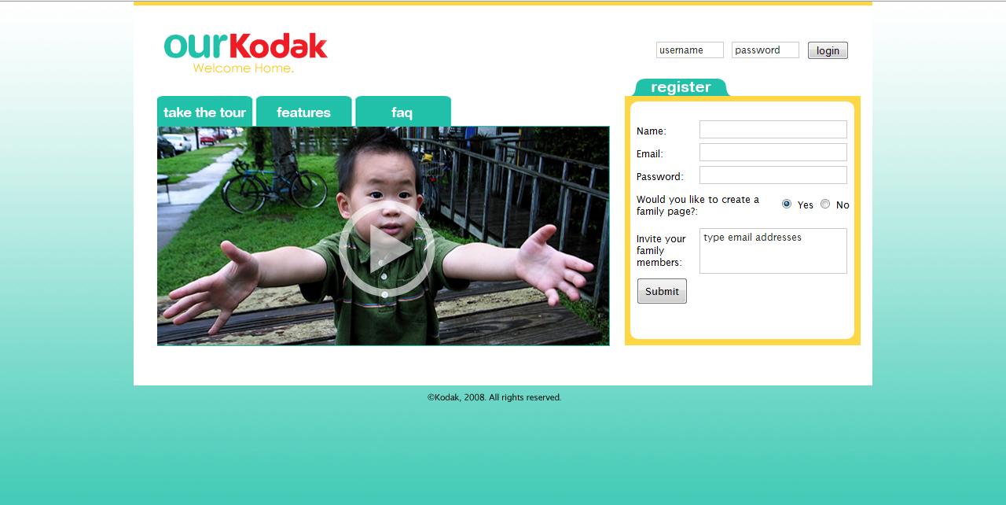
ourKodak Homepage

Slide 42
ourKodak Homepage

Slide 43
ourKodak Homepage

Slide 44
Networked Family Accounts
Mary

Slide 45
Networked Family Accounts
Mary

Slide 46
Networked Family Accounts
Mary
The Smiths

Slide 47
Networked Family Accounts
Mary
The Smiths

Slide 48
Networked Family Accounts
Mary
The Smiths
The Browns

Slide 49
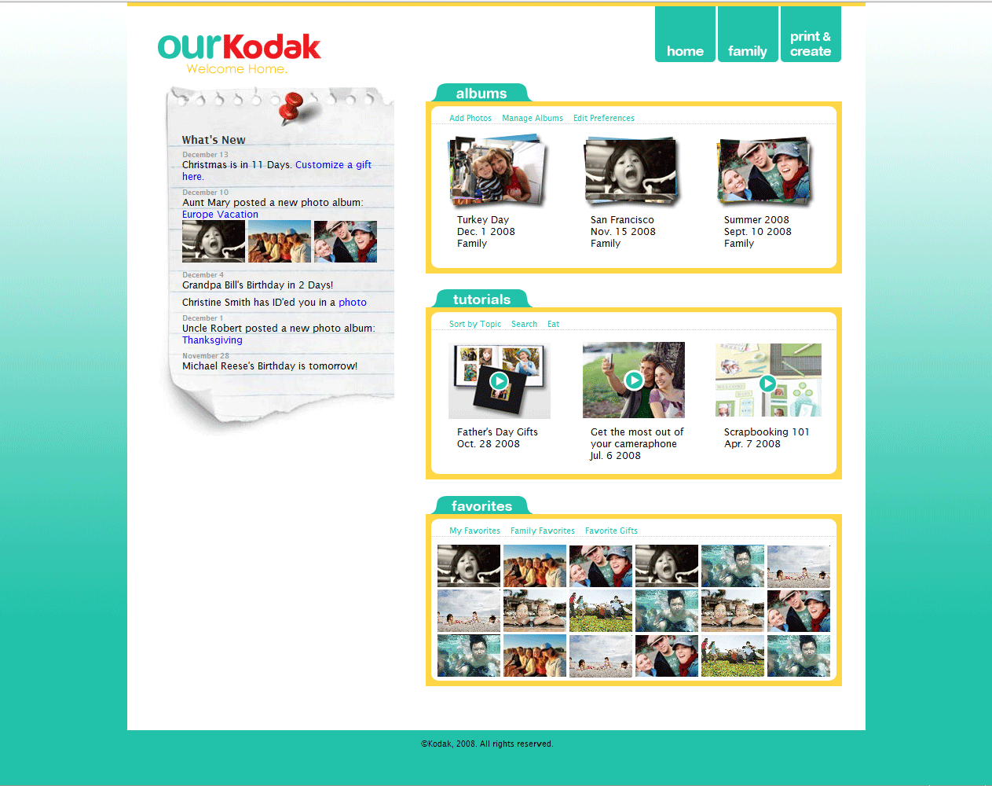
User’s Personalized Homepage

Slide 50
User’s Personalized Homepage

Slide 51
User’s Personalized Homepage

Slide 52
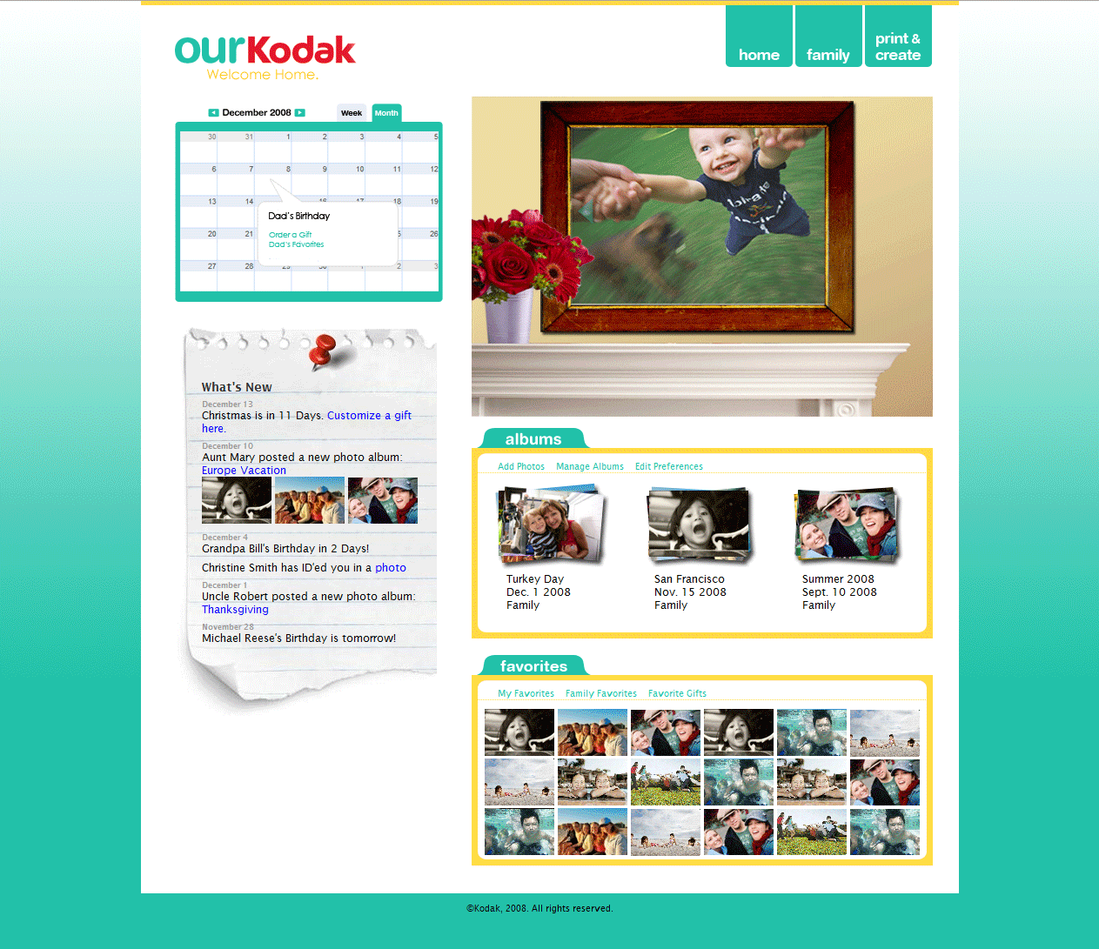
Family Homepage

Slide 53
Family Homepage

Slide 54
Family Homepage

Slide 55
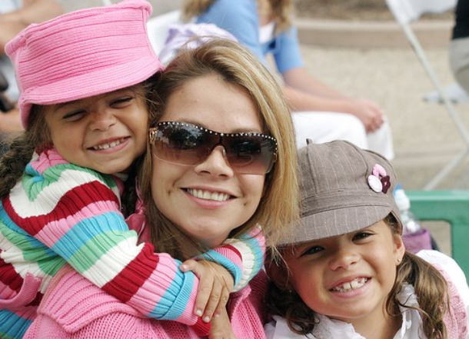
Family Reunion Album
Holly
Listen to Album Story
Write a Comment…
Listen to Voice Comments
Album Viewing Features
Comment | Leave a Voice Comment

Slide 56
Family Homepage

Slide 57
Print & Create

Slide 58
Print & Create

Slide 59
Print & Create

Slide 60
Active Diffusion of ourKodak

Slide 61
Summary of Monetization
Bulletin Board | Aggregate information with integrated purchase suggestions
Family Moments Calendar | Inform users of occasions and events to promote printing and gifting
Toolbar | Provide one-click purchase opportunities when viewing photos
Favorites | Offer relevant suggestions to increase gifting and purchases
E-mail Reminders | Continuously bring users back to the site

Slide 62
strategy website [imc]
the next generation :: Kodak Gallery

Slide 63
IMC Messaging
Website Banner Ads
Print Ads
Buzz
Out-of-Home Ads
Promotions
Contests
Blogs
Experiential Marketing

Slide 64
IMC Messaging
Website Banner Ads | Through ourKodak, families can use photos and technology to rekindle the feelings and emotions of home.
Print Ads
Buzz
Out-of-Home Ads
Promotions
Contests
Blogs
Experiential Marketing
“
”

Slide 65
IMC Three-Phase Plan
Expose
Capture
Develop

Slide 66
IMC Three-Phase Plan
Expose
Create broad awareness of new positioning
Capture
Develop

Slide 67
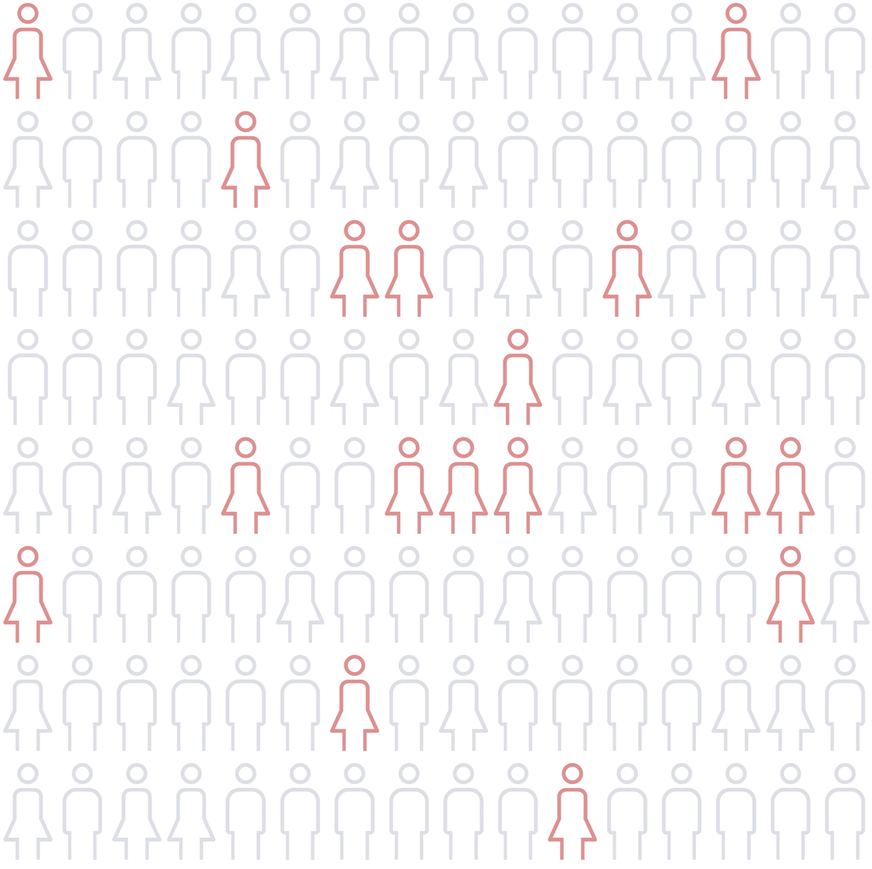
IMC Three-Phase Plan
Expose
Capture
Induce trial amongst mothers
Develop

Slide 68
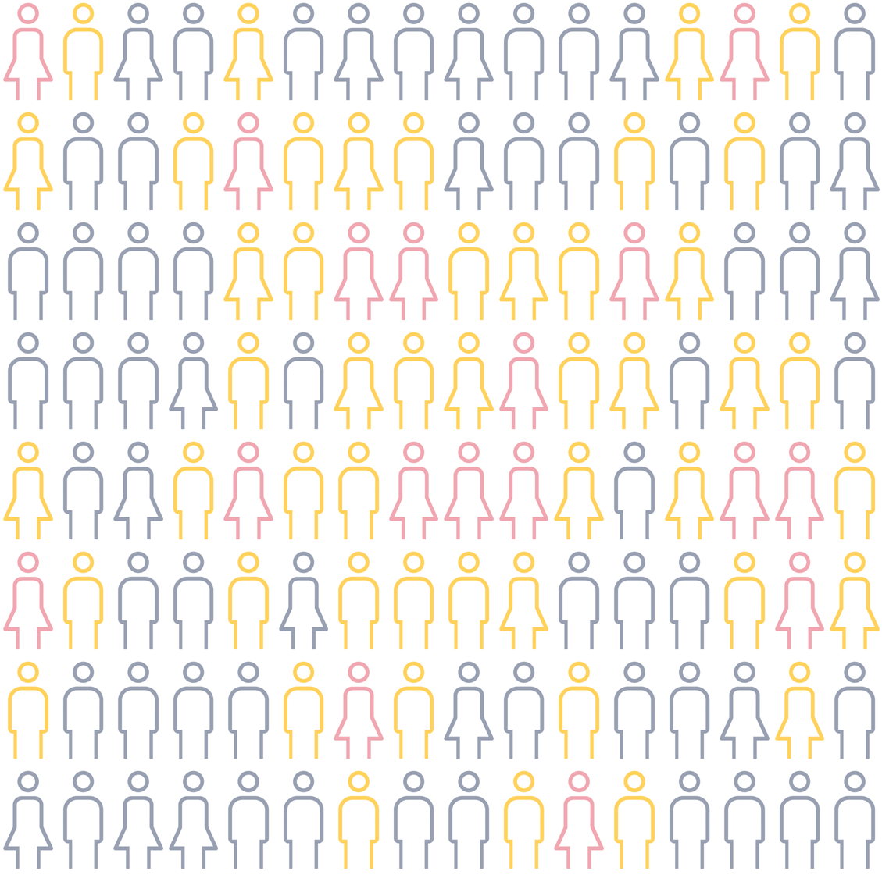
IMC Three-Phase Plan
Expose
Capture
Develop
Cultivate relationship with all generations of the family

Slide 69
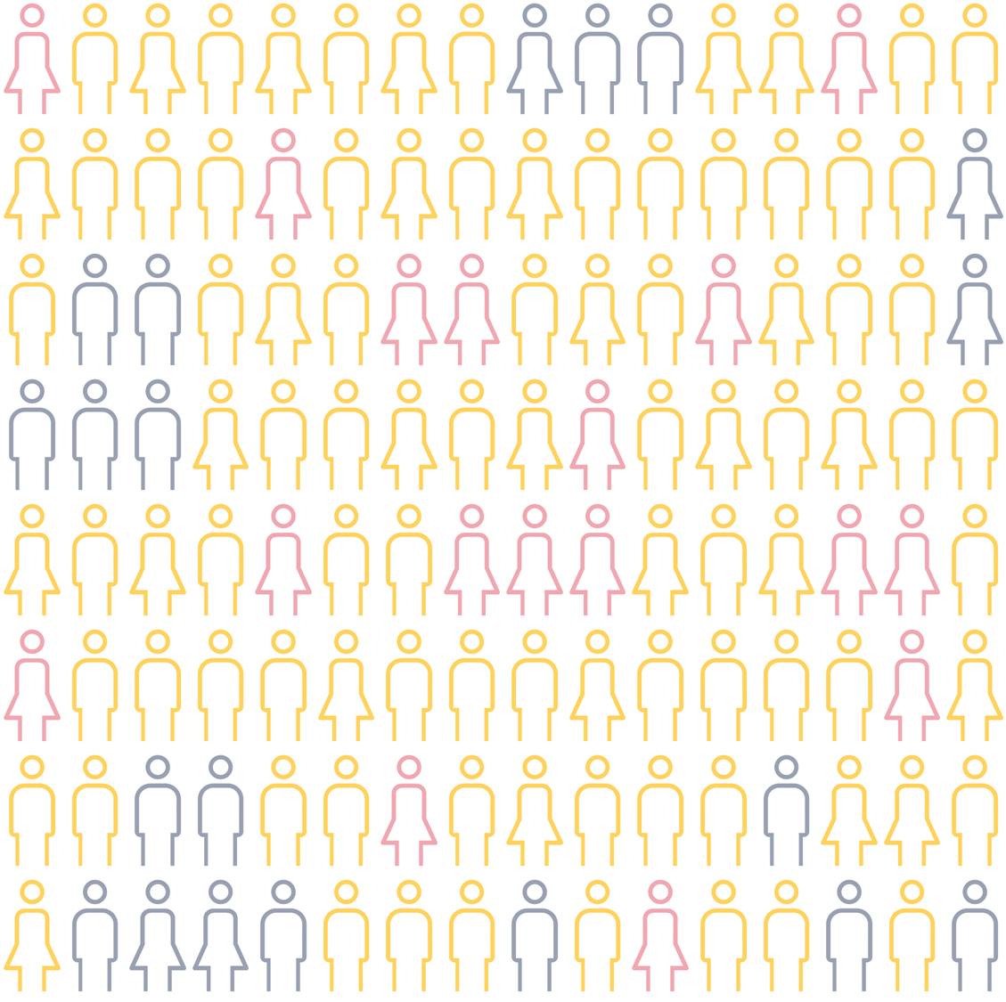
IMC Three-Phase Plan
Expose
Capture
Develop
Cultivate relationship with all generations of the family

Slide 70
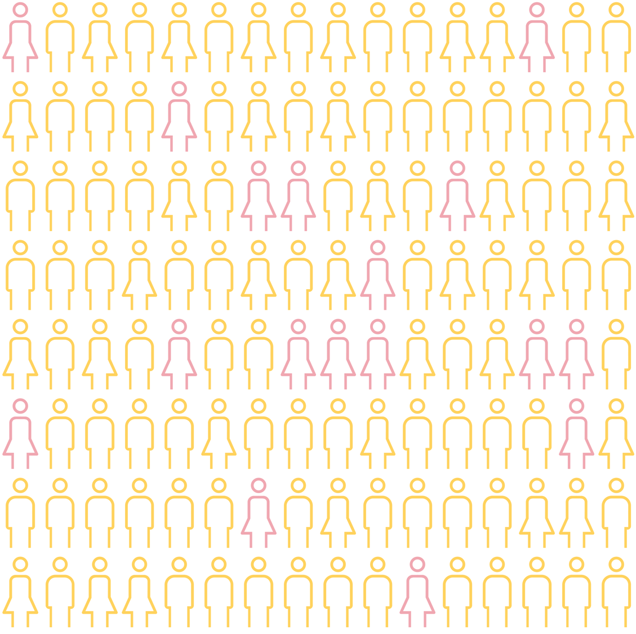
IMC Three-Phase Plan
Expose
Capture
Develop
Cultivate relationship with all generations of the family

Slide 71
Expose Phase Create Broad Awareness of New Positioning
Expose
Capture
Develop
Reach
Print Ads:
3,803,217/week
Online Banner Ads:
4,100,000/month
Out-of-Home:
10,077,799/month

Slide 72
Print Advertisements
Page 1

Slide 73
Print Advertisements
Page 2

Slide 74
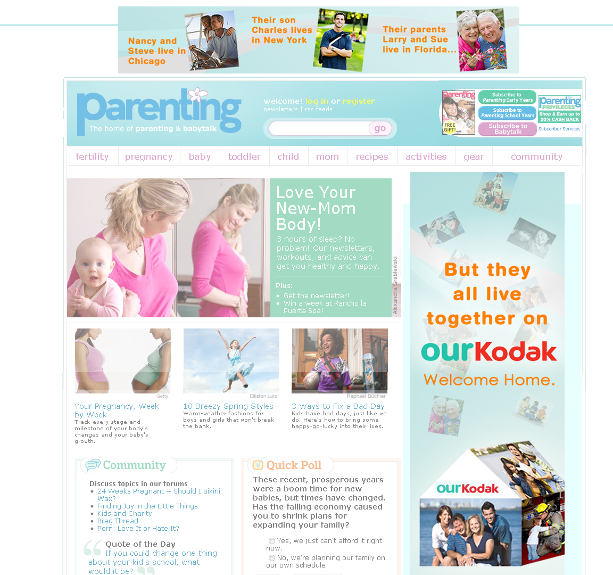
Online Banner Advertisements

Slide 75
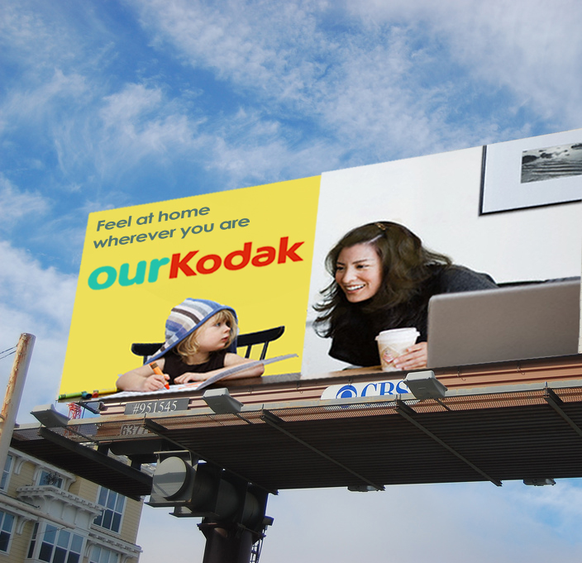
Out-of-Home Advertisements

Slide 76
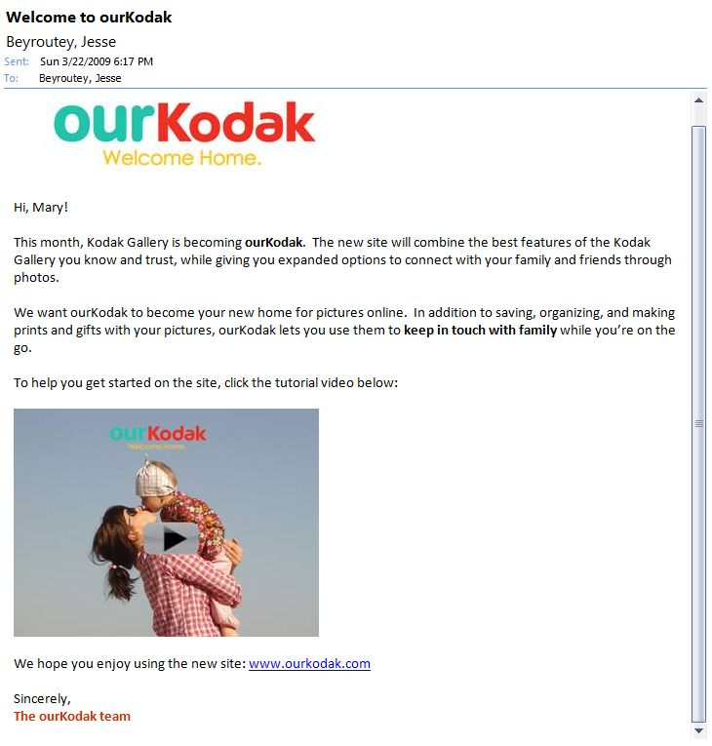
E-Mail Campaign
to Current Users

Slide 77
Capture Phase Induce Trial Among Mothers
Tactic | Medium | Objective
Blog Articles | Blogs | To create buzz amongst online mothers
ourKodak Print Discount | In-Store Promotion | To monetize users who print in-store only
Referral System | Email | To utilize gatekeeper status to reach other mothers
Airport Photo Kiosks | Experiential Marketing | To reach mothers during free time

Slide 78
Capture Phase Induce Trial Among Mothers
Tactic | Medium | Objective
Blog Articles | Blogs | To create buzz amongst online mothers
ourKodak Print Discount | In-Store Promotion | To monetize users who print in-store only
Referral System | Email | To utilize gatekeeper status to reach other mothers
Airport Photo Kiosks | Experiential Marketing | To reach mothers during free time

Slide 79
Capture Phase Induce Trial Among Mothers
Tactic | Medium | Objective
Blog Articles | Blogs | To create buzz amongst online mothers
ourKodak Print Discount | In-Store Promotion | To monetize users who print in-store only
Referral System | Email | To utilize gatekeeper status to reach other mothers
Airport Photo Kiosks | Experiential Marketing | To reach mothers during free time

Slide 80
Capture Phase Induce Trial Among Mothers
Tactic | Medium | Objective
Blog Articles | Blogs | To create buzz amongst online mothers
ourKodak Print Discount | In-Store Promotion | To monetize users who print in-store only
Referral System | Email | To utilize gatekeeper status to reach other mothers
Airport Photo Kiosks | Experiential Marketing | To reach mothers during free time

Slide 81
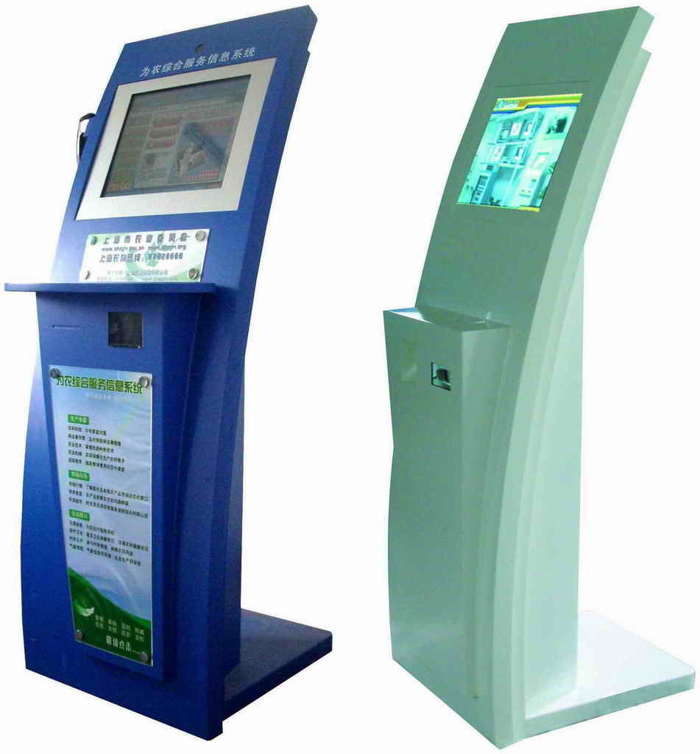
Capture Phase Induce Trial Among Mothers
Tactic | Medium | Objective
Blog Articles | Blogs | To create buzz amongst online mothers
ourKodak Print Discount | In-Store Promotion | To monetize users who print in-store only
Referral System | Email | To utilize gatekeeper status to reach other mothers
Airport Photo Kiosks | Experiential Marketing | To reach mothers during free time

Slide 82
Develop Phase Cultivate Relationship with Multiple Generations
Tactic | Medium | Objective
Grandparent Tutorial | Email | Induce grandparent account creation
Facebook Easy Upload Tool | Facebook | Streamline upload process for teenagers
Valentine’s Day “Free Picture Message” Promotion | Partnership | Induce account creation within families and connect ourKodak to mobile media
Intergenerational Photo Contest | Online Contest | Target all generations and support an intergenerational strategy

Slide 83
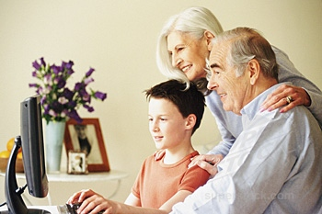
Develop Phase Cultivate Relationship with Multiple Generations
Tactic | Medium | Objective
Grandparent Tutorial | Email | Induce grandparent account creation
Facebook Easy Upload Tool | Facebook | Streamline upload process for teenagers
Valentine’s Day “Free Picture Message” Promotion | Partnership | Induce account creation within families and connect ourKodak to mobile media
Intergenerational Photo Contest | Online Contest | Target all generations and support an intergenerational strategy

Slide 84
Develop Phase Cultivate Relationship with Multiple Generations
Tactic | Medium | Objective
Grandparent Tutorial | Email | Induce grandparent account creation
Facebook Easy Upload Tool | Facebook | Streamline upload process for teenagers
Valentine’s Day “Free Picture Message” Promotion | Partnership | Induce account creation within families and connect ourKodak to mobile media
Intergenerational Photo Contest | Online Contest | Target all generations and support an intergenerational strategy

Slide 85
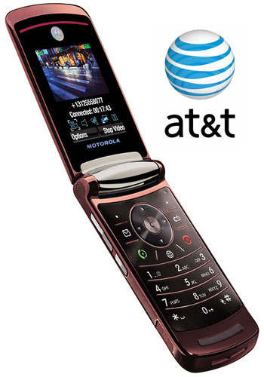
Develop Phase Cultivate Relationship with Multiple Generations
Tactic | Medium | Objective
Grandparent Tutorial | Email | Induce grandparent account creation
Facebook Easy Upload Tool | Facebook | Streamline upload process for teenagers
Valentine’s Day “Free Picture Message” Promotion | Partnership | Induce account creation within families and connect ourKodak to mobile media
Intergenerational Photo Contest | Online Contest | Target all generations and support an intergenerational strategy

Slide 86
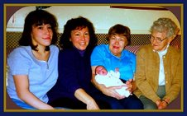
Develop Phase Cultivate Relationship with Multiple Generations
Tactic | Medium | Objective
Grandparent Tutorial | Email | Induce grandparent account creation
Facebook Easy Upload Tool | Facebook | Streamline upload process for teenagers
Valentine’s Day “Free Picture Message” Promotion | Partnership | Induce account creation within families and connect ourKodak to mobile media
Intergenerational Photo Contest | Online Contest | Target all generations and support an intergenerational strategy

Slide 87
IMC Objectives
Expose
Capture
Develop

Slide 88
IMC Objectives
Expose
Created broad awareness of new positioning
Capture
Develop

Slide 89
IMC Objectives
Expose
Capture
Attracted mothers with emotional benefits
Develop

Slide 90
IMC Objectives
Expose
Capture
Develop
Leveraged mothers to enlarge user base

Slide 91
IMC Timeline
 | Expose |  | Capture |  |  |  |  |  | Develop
IMC Tactic | Jun | Jul | Aug | Sep | Oct | Nov | Dec | Jan | Feb | Mar | Apr | May
“Welcome Home” Ads
“Away from Home” Billboards
Airport Kiosks
Referral System
Retail Prints Discount Code
Blog Articles
Facebook Easy Upload App
Valentine’s Day Promotion
Grandparent E-mail Tutorial
Intergenerational Contest

Slide 92
IMC Timeline
 | Expose |  | Capture |  |  |  |  |  | Develop
IMC Tactic | Jun | Jul | Aug | Sep | Oct | Nov | Dec | Jan | Feb | Mar | Apr | May
“Welcome Home” Ads
“Away from Home” Billboards
Airport Kiosks
Referral System
Retail Prints Discount Code
Blog Articles
Facebook Easy Upload App
Valentine’s Day Promotion
Grandparent E-mail Tutorial
Intergenerational Contest

Slide 93
IMC Budget
Tactics | Cost
Repositioning
Print Advertising | $244,600
Online Marketing | 320,000
Out-of-Home Communications | 108,000
Inducing Trial
Airport Kiosks | $100,500
Consumer Referral Program | 100,000
Print Coupon Program | 100,000
Cultivating Relationships
Valentine's Day Picture Messages | $2,800
Facebook Application | 15,000
Intergenerational Contest | 980
TOTAL COST | $991,880
Notes:
93

Slide 94
[takeaways]
the next generation :: Kodak Gallery

Slide 95
Growth Opportunity

Slide 96
Website Profitability
Notes:
Currently 16% of users create gifts, we forecast that number to grow to 25% of users by year 4.

Slide 97
Concerns and Solutions
Kodak’s Concerns | Our Solutions
Who should Kodak target and how should the next generation of the Kodak Gallery be positioned? | Connector Moms will serve as gatekeepers to other generations The Virtual Home will provide them with emotional benefits
What features, services, and capabilities must the Gallery offer in order to maintain market leadership and stay relevant with changing consumer trends? | Enable emotional, not just functional, connection over a digital platform
How can we monetize Gallery users? | Integrate purchase opportunities that support the value proposition
How should we launch the next generation of Kodak Gallery? | Expose potential users Capture trial Develop growth

Slide 98
Concerns and Solutions
Kodak’s Concerns | Our Solutions
Who should Kodak target and how should the next generation of the Kodak Gallery be positioned? | Connector Moms will serve as gatekeepers to other generations The Virtual Home will provide them with emotional benefits
What features, services, and capabilities must the Gallery offer in order to maintain market leadership and stay relevant with changing consumer trends? | Enable emotional, not just functional, connection over a digital platform
How can we monetize Gallery users? | Integrate purchase opportunities that support the value proposition
How should we launch the next generation of Kodak Gallery? | Expose potential users Capture trial Develop growth

Slide 99
Concerns and Solutions
Kodak’s Concerns | Our Solutions
Who should Kodak target and how should the next generation of the Kodak Gallery be positioned? | Connector Moms will serve as gatekeepers to other generations The Virtual Home will provide them with emotional benefits
What features, services, and capabilities must the Gallery offer in order to maintain market leadership and stay relevant with changing consumer trends? | Enable emotional, not just functional, connection over a digital platform
How can we monetize Gallery users? | Integrate purchase opportunities that support the value proposition
How should we launch the next generation of Kodak Gallery? | Expose potential users Capture trial Develop growth

Slide 100
Concerns and Solutions
Kodak’s Concerns | Our Solutions
Who should Kodak target and how should the next generation of the Kodak Gallery be positioned? | Connector Moms will serve as gatekeepers to other generations The Virtual Home will provide them with emotional benefits
What features, services, and capabilities must the Gallery offer in order to maintain market leadership and stay relevant with changing consumer trends? | Enable emotional, not just functional, connection over a digital platform
How can we monetize Gallery users? | Integrate purchase opportunities that support the value proposition
How should we launch the next generation of Kodak Gallery? | Expose potential users Capture trial Develop growth

Slide 101
Concerns and Solutions
Kodak’s Concerns | Our Solutions
Who should Kodak target and how should the next generation of the Kodak Gallery be positioned? | Connector Moms will serve as gatekeepers to other generations The Virtual Home will provide them with emotional benefits
What features, services, and capabilities must the Gallery offer in order to maintain market leadership and stay relevant with changing consumer trends? | Enable emotional, not just functional, connection over a digital platform
How can we monetize Gallery users? | Integrate purchase opportunities that support the value proposition
How should we launch the next generation of Kodak Gallery? | Expose potential users Capture trial Develop growth

Slide 103
Questions?
Presentation Sections
Strategy
Website
IMC
Takeaways
Other Concerns
Alienation of current users
Justification for emphasis on family connections
Purchase motivation and revenue drivers
Mobile phone media
Video upload capabilities
Differentiation from social networking sites
Risk mitigation
Mothers as gatekeepers to younger generations
Market segmentation details

Slide 104
How do we know we are not alienating the current users of Kodak Gallery through the repositioning?
Easier-to-use interface
Core features retained on the site, plus new value-adding features
High switching costs
Brings Kodak up to speed/leap ahead of the pack of standard

Slide 105
Why does the repositioning place such heavy emphasis on a family website experience?
Less competition
Current competitors are small and extremely niche-oriented
Natural defense against new entrants and changing technologies
Need for connections are eternal and unchanging despite technological advancement

Slide 106
How do we expect to motivate purchases and drive overall revenue?
Gift recommendations that cater to family occasions, allowing more purchases
Easy, streamlined gifting process
Favorite, Edit, Print, Create
Reminders to return to the site in order to purchase gifts and prints

Slide 107
How do we address mobile phone technologies?
Camera phone technology is still not capable to produce high-quality photos
Current ourKodak Strategy:
Developing Mobile tactics for current users
Create tutorials to introduce mobile photo sharing
When the technology is ready, the moms are ready, Kodak well poised to take leadership position

Slide 108
How do we address video uploads?
Videos are hard to monetize due to expenses associated with bandwidth and storage
Directly charging people for storage goes against Kodak’s emotional ties to the consumers
Therefore, current strategy does not emphasize video uploading
If profitability increases in the future, this could be a potential opportunity

Slide 109
How is this different from social networking websites such as Facebook?
ourKodak focuses on smaller, more intimate networks fostering emotions and connections associated with loved ones rather than casual friends and acquaintances
Since ourKodak is tailored towards a more concentrated market, they are able to offer more customized services
Though parents can have Facebook profiles, teens are still hesitant to share their photos and allow parents to join their networks
ourKodak gives users the opportunity to buy customized gifts for loved ones

Slide 110
Risk Mitigation: Strategic Options
Tactic | Cost | Validation | Option
Print & Billboard Ads | $390,000 | Brand perception and awareness survey | Add features Divest from ourKodak
Online Ads (First wave) | $100,000 | Click-through rate Signup rate | Reduce second wave Add $250,000 more to induce trials
Online Ads (Second wave) | $250,000 | Prior user adoption rate New user signups | Return to the original Kodak Gallery design
Referral System & Airport Kiosks | $140,000 | Trial rate Average order size | Eliminate print program
Print Program & Relationships | $120,000 | Profitability | Additional campaigns Divest from ourKodak

Slide 111
How are mothers gatekeepers for their children?
Mothers exercise significant influences over the purchasing choices of their children
For younger children, mothers are also gatekeepers to their entertainment
Provide cues for purchasing decisions when children reach the correct life-stage
Statement | % Agreement
The child is not allowed to go on the web without adult supervision | 51.6
I rely on an Internet company’s parent control or kid portal | 11
I use my own parental-control program to lock out certain sites | 7.3
No Rules: I trust the child to choose wisely | 7.4
Mediamark Research Inc. “Mothers Active Gatekeepers of Internet, TV and Video Game Usage Among Children Ages 6-11”

Slide 112
Market Segmentation
Segment | Variety of Gifts | Ability to Share | Storage Capacity | Quality of Tools | Speed of Delivery | Quality of Prints | Low Cost | Active Community
Community Carol | 1.31 | 3.34 | 2.64 | 2.47 | 2.82 | 3.63 | 2.9 | 1.28
Connector Connie | 2.1 | 3.6 | 3.43 | 3.61 | 3.57 | 3.88 | 3.63 | 1.86
Creative Kate | 1.22 | 1.53 | 1.61 | 2.86 | 3.42 | 3.8 | 3.44 | 1.25
Safety Susan | 1.27 | 1.8 | 1.41 | 1.44 | 1.89 | 2.98 | 2.39 | 1.14

